Slide 1
CHAPTER 5
Trees
All the programs in this file are selected from
Ellis Horowitz, Sartaj Sahni, and Susan Anderson-Freed
“Fundamentals of Data Structures in C”,
Computer Science Press, 1992.

Slide 2
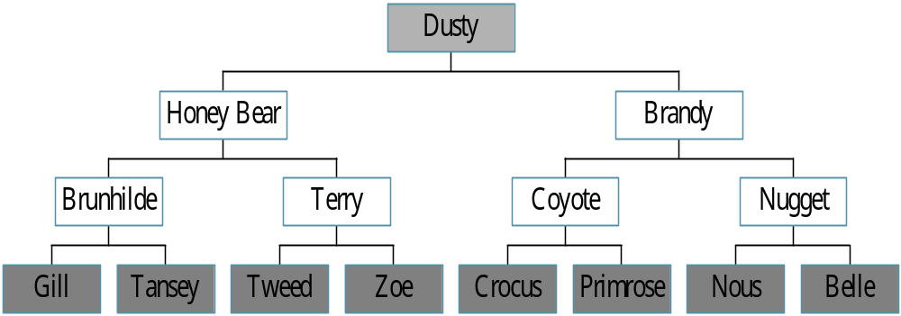
Trees
Root
leaf
CHAPTER 5

Slide 3
Definition of Tree
A tree is a finite set of one or more nodes
such that:
There is a specially designated node called
the root.
The remaining nodes are partitioned into n>=0 disjoint sets T1, ..., Tn, where each of these sets is a tree.
We call T1, ..., Tn the subtrees of the root.
CHAPTER 5

Slide 4
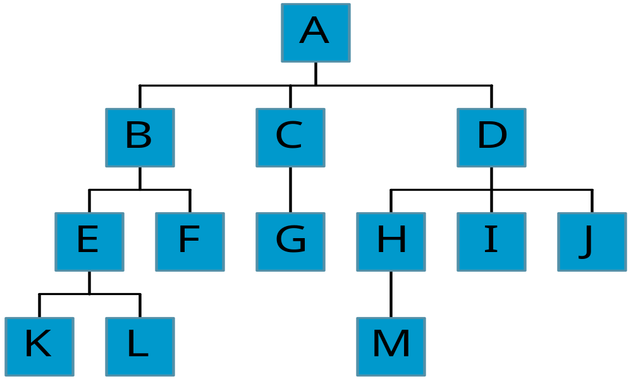
Level and Depth
Level
1
2
3
4
node (13)
degree of a node
leaf (terminal)
nonterminal
parent
children
sibling
degree of a tree (3)
ancestor
level of a node
height of a tree (4)
3
1
2
2
1
2
3
2
2
3
3
3
3
0
1
3
3
0
0
0
0
4
0
4
0
4
CHAPTER 5

Slide 5
Terminology
The degree of a node is the number of subtrees
of the node
  The degree of A is 3; the degree of C is 1.
The node with degree 0 is a leaf or terminal
node.
A node that has subtrees is the parent of the
roots of the subtrees.
The roots of these subtrees are the children of
the node.
Children of the same parent are siblings.
The ancestors of a node are all the nodes
along the path from the root to the node.
CHAPTER 5

Slide 6
Representation of Trees
List Representation
  ( A ( B ( E ( K, L ), F ), C ( G ), D ( H ( M ), I, J ) ) )
  The root comes first, followed by a list of sub-trees
data
link 1
link 2
...
link n
How many link fields are
needed in such a representation?
CHAPTER 5

Slide 7
Left Child - Right Sibling
data
A
left child
right sibling
B
C
D
E
F
G
H
I
J
K
L
M
CHAPTER 5

Slide 8
Binary Trees
A binary tree is a finite set of nodes that is
either empty or consists of a root and two
disjoint binary trees called the left subtree
and the right subtree.
Any tree can be transformed into binary tree.
  by left child-right sibling representation
The left subtree and the right subtree are distinguished.
CHAPTER 5

Slide 9
*Figure 5.6: Left child-right child tree representation of a tree (p.191)
A
B
E
C
G
D
K
F
H
L
M
I
J

Slide 10
Abstract Data Type Binary_Tree
structure Binary_Tree(abbreviated BinTree) is
objects: a finite set of nodes either empty or
consisting of a root node, left Binary_Tree,
and right Binary_Tree.
functions:
for all bt, bt1, bt2 ∈ BinTree, item ∈ element
Bintree Create()::= creates an empty binary tree
Boolean IsEmpty(bt)::= if (bt==empty binary
tree) return TRUE else return FALSE
CHAPTER 5

Slide 11
BinTree MakeBT(bt1, item, bt2)::= return a binary tree
whose left subtree is bt1, whose right subtree is bt2,
and whose root node contains the data item
Bintree Lchild(bt)::= if (IsEmpty(bt)) return error
else return the left subtree of bt
element Data(bt)::= if (IsEmpty(bt)) return error
else return the data in the root node of bt
Bintree Rchild(bt)::= if (IsEmpty(bt)) return error
else return the right subtree of bt
CHAPTER 5

Slide 12
Samples of Trees
Complete Binary Tree
A
A
1
A
B
B
2
B
C
C
Skewed Binary Tree
3
D
E
F
G
D
4
H
I
E
5
CHAPTER 5

Slide 13
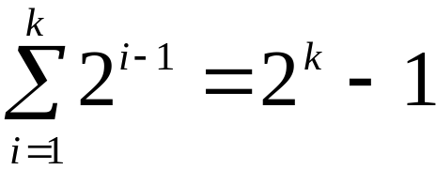
Maximum Number of Nodes in BT
The maximum number of nodes on level i of a binary tree is 2^{i-1}, i>=1.
The maximum nubmer of nodes in a binary tree
of depth k is 2^{k}-1, k>=1.
i-1
Prove by induction.
CHAPTER 5

Slide 14
Relations between Number of
Leaf Nodes and Nodes of Degree 2
For any nonempty binary tree, T, if n0 is the
number of leaf nodes and n2 the number of nodes
of degree 2, then n0=n2+1
proof:
Let n and B denote the total number of nodes &
branches in T.
Let n0, n1, n2 represent the nodes with no children,
single child, and two children respectively.
n= n0+n1+n2, B+1=n, B=n1+2n2 ==> n1+2n2+1= n,
n1+2n2+1= n0+n1+n2 ==> n0=n2+1
CHAPTER 5

Slide 15
Full BT VS Complete BT
A full binary tree of depth k is a binary tree of
depth k having 2 -1 nodes, k>=0.
A binary tree with n nodes and depth k is
complete iff its nodes correspond to the nodes numbered from 1 to n in the full binary tree of
depth k.
k
由上至下，
由左至右編號
A
A
B
C
B
C
D
E
F
G
D
E
F
G
H
H
I
J
K
L
M
N
O
I
Complete binary tree
Full binary tree of depth 4
CHAPTER 5

Slide 16
Binary Tree Representations
If a complete binary tree with n nodes (depth =
log n + 1) is represented sequentially, then for
any node with index i, 1<=i<=n, we have:
  parent(i) is at i/2 if i!=1. If i=1, i is at the root and
  has no parent.
  left_child(i) ia at 2i if 2i<=n. If 2i>n, then i has no
  left child.
  right_child(i) ia at 2i+1 if 2i +1 <=n. If 2i +1 >n,
  then i has no right child.
CHAPTER 5

Slide 17
Sequential Representation
[1]
[2]
[3]
[4]
[5]
[6]
[7]
[8]
[9]
A
B
C
D
E
F
G
H
I
(1) waste space
(2) insertion/deletion
problem
A
[1]
[2]
[3]
[4]
[5]
[6]
[7]
[8]
[9]
.
[16]
A
B
--
C
--
--
--
D
--
.
E
B
A
C
B
C
D
D
E
F
G
E
H
I
CHAPTER 5

Slide 18
Linked Representation
typedef struct node *tree_pointer;
typedef struct node {
int data;
tree_pointer left_child, right_child;
};
data
left_child
data
right_child
left_child
right_child
CHAPTER 5

Slide 19
Binary Tree Traversals
Let L, V, and R stand for moving left, visiting
the node, and moving right.
There are six possible combinations of traversal
  LVR, LRV, VLR, VRL, RVL, RLV
Adopt convention that we traverse left before
right, only 3 traversals remain
  LVR, LRV, VLR
  inorder, postorder, preorder
CHAPTER 5

Slide 20
Arithmetic Expression Using BT
+
inorder traversal
A / B * C * D + E
infix expression
preorder traversal
+ * * / A B C D E
prefix expression
postorder traversal
A B / C * D * E +
postfix expression
level order traversal
+ * E * D / C A B
*
E
*
D
/
C
A
B
CHAPTER 5

Slide 21
Inorder Traversal (recursive version)
void inorder(tree_pointer ptr)
/* inorder tree traversal */
{
if (ptr) {
inorder(ptr->left_child);
printf(“%d”, ptr->data);
indorder(ptr->right_child);
}
}
A / B * C * D + E
CHAPTER 5

Slide 22
Preorder Traversal (recursive version)
void preorder(tree_pointer ptr)
/* preorder tree traversal */
{
if (ptr) {
printf(“%d”, ptr->data);
preorder(ptr->left_child);
predorder(ptr->right_child);
}
}
+ * * / A B C D E
CHAPTER 5

Slide 23
Postorder Traversal (recursive version)
void postorder(tree_pointer ptr)
/* postorder tree traversal */
{
if (ptr) {
postorder(ptr->left_child);
postdorder(ptr->right_child);
printf(“%d”, ptr->data);
}
}
A B / C * D * E +
CHAPTER 5

Slide 24
Iterative Inorder Traversal
(using stack)
void iter_inorder(tree_pointer node)
{
int top= -1; /* initialize stack */
tree_pointer stack[MAX_STACK_SIZE];
for (;;) {
for (; node; node=node->left_child)
add(&top, node);/* add to stack */
node= delete(&top);
/* delete from stack */
if (!node) break; /* empty stack */
printf(“%D”, node->data);
node = node->right_child;
}
}
O(n)
CHAPTER 5

Slide 25
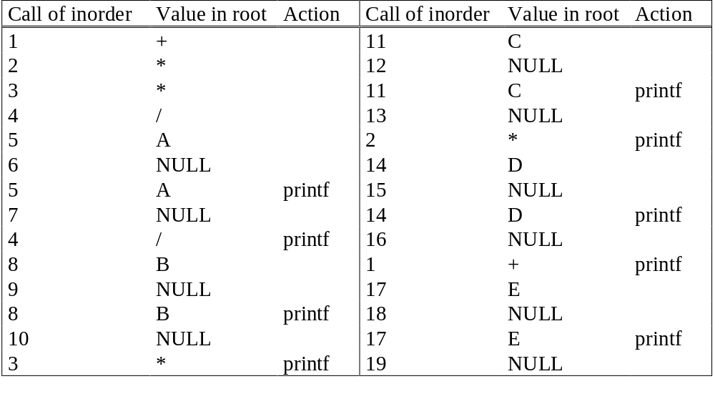
Trace Operations of Inorder Traversal
CHAPTER 5

Slide 26
Threaded Binary Trees
Two many null pointers in current representation
of binary trees
n: number of nodes
number of non-null links: n-1
total links: 2n
null links: 2n-(n-1)=n+1
Replace these null pointers with some useful “threads”.
CHAPTER 5

Slide 27
In a binary search tree, there are many nodes that have an empty left child or empty right child or both.
You can utilize these fields in such a way so that the empty left child of a node points to its inorder predecessor and empty right child of the node points to its inorder successor.
CHAPTER 5

Slide 28
Threaded Binary Trees (Continued)
If ptr->left_child is null,
replace it with a pointer to the node that would be
visited before ptr in an inorder traversal
If ptr->right_child is null,
replace it with a pointer to the node that would be
visited after ptr in an inorder traversal
CHAPTER 5

Slide 29
A Threaded Binary Tree
root
A
dangling
B
C
dangling
D
E
F
G
inorder traversal:
H, D, I, B, E, A, F, C, G
H
I
CHAPTER 5

Slide 30
One way threading:- A thread will appear in a right field of a node and will point to the next node in the inorder traversal.
Two way threading:- A thread will also appear in the left field of a node and will point to the preceding node in the inorder traversal.
CHAPTER 5

Slide 31
Data Structures for Threaded BT
left_thread left_child data right_child right_thread
TRUE
●
●
FALSE
TRUE: thread
FALSE: child
typedef struct threaded_tree *threaded_pointer;
typedef struct threaded_tree {
short int left_thread;
threaded_pointer left_child;
char data;
threaded_pointer right_child;
short int right_thread; };

Slide 32
Memory Representation of A Threaded BT
root
--
f
f
f
A
f
f
B
f
f
C
f
f
D
f
t
E
t
t
F
t
t
G
t
t
H
t
t
I
t
CHAPTER 5

Slide 33
Next Node in Threaded BT
threaded_pointer insucc(threaded_pointer tree)
{
threaded_pointer temp;
temp = tree->right_child;
if (!tree->right_thread)
while (!temp->left_thread)
temp = temp->left_child;
return temp;
}
CHAPTER 5

Slide 34
Inorder Traversal of Threaded BT
void tinorder(threaded_pointer tree)
{
/* traverse the threaded binary tree inorder */
threaded_pointer temp = tree;
for (;;) {
temp = insucc(temp);
if (temp==tree) break;
printf(“%3c”, temp->data);
}
}
O(n)
CHAPTER 5

Slide 35
Inserting Nodes into Threaded BTs
Insert child as the right child of node parent
  change parent->right_thread to FALSE
  set child->left_thread and child->right_thread to TRUE
  set child->left_child to point to parent
  set child->right_child to parent->right_child
  change parent->right_child to point to child
CHAPTER 5

Slide 36
Examples
Insert a node D as a right child of B.
root
root
A
A
(1)
B
parent
B
parent
(3)
child
child
C
D
C
D
(2)
empty
CHAPTER 5

Slide 37
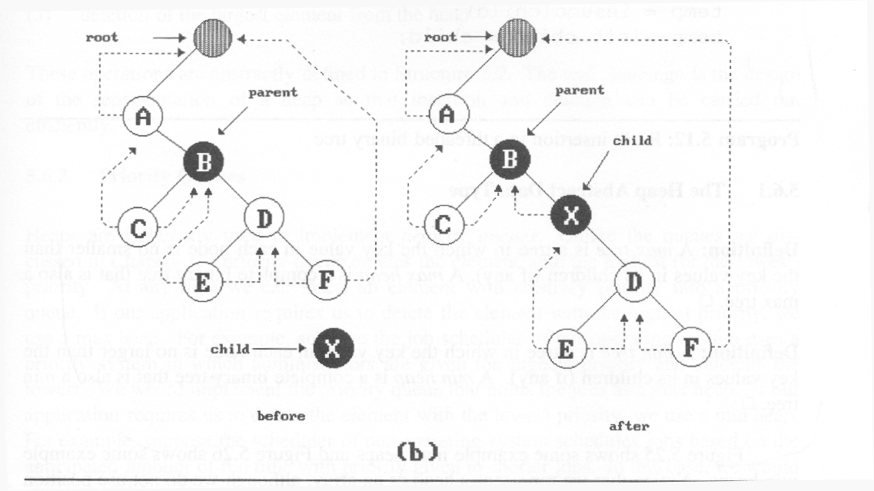
*Figure : Insertion of child as a right child of parent in a threaded binary tree
(3)
(2)
(1)
(4)
nonempty

Slide 38
Right Insertion in Threaded BTs
void insert_right(threaded_pointer parent,
threaded_pointer child)
{
threaded_pointer temp;
child->right_child = parent->right_child;
child->right_thread = parent->right_thread;
child->left_child = parent; case (a)
child->left_thread = TRUE;
parent->right_child = child;
parent->right_thread = FALSE;
if (!child->right_thread) { case (b)
temp = insucc(child);
temp->left_child = child;
}
}
(1)
(2)
(3)
(4)
CHAPTER 5

